Slide 1
Merrimack Conservation Partnership

Slide 2
Why the Merrimack?
In 2010 the Merrimack was identified by the US Forest Service as the most threatened watershed in the nation in terms of projected loss of private forest land over the next twenty years.
The watershed’s 2.6 million residents directly depend on the Merrimack watershed for drinking water, local food and forest products, and close-to-home outdoor recreation.
Despite being highly developed, the Merrimack Valley still contains critical terrestrial and aquatic habitats, and contributes to the larger Gulf of Maine marine ecosystem.

Slide 3
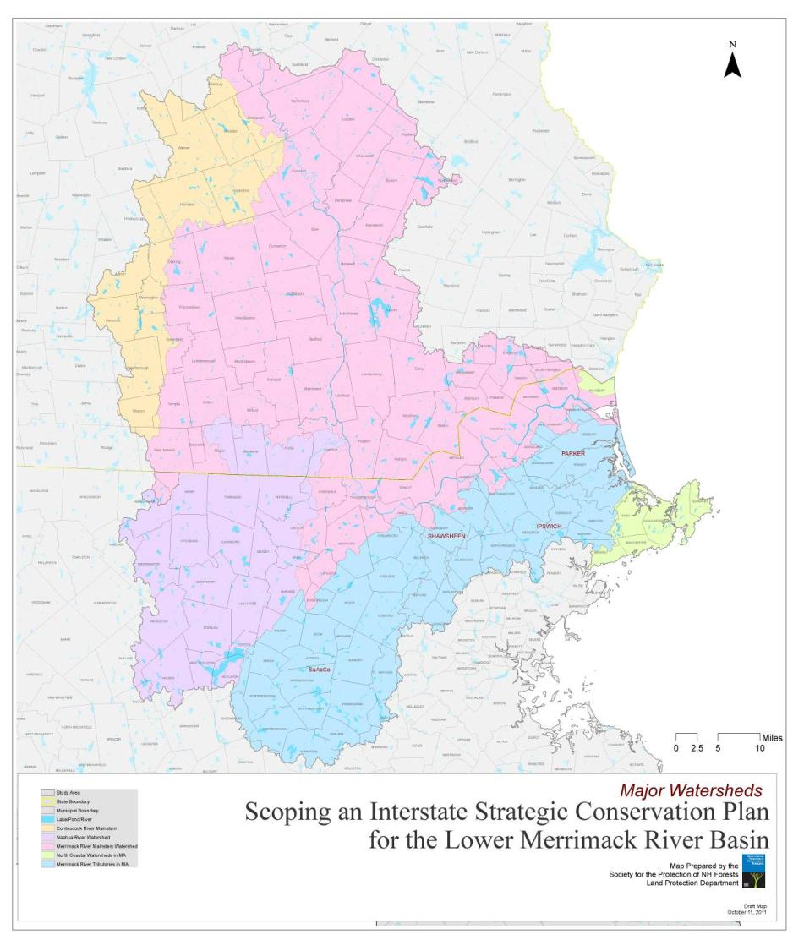
Why the Merrimack?
Concord
Merrimack watershed totals about 3,275 square miles or 2.1 million acres, divided almost evenly between NH (54%) and MA (46%).
From its start in Franklin, the Merrimack River flows through eight of the New Hampshire’s ten largest cities, including Manchester, Nashua and Concord.
River continues into MA, running through cities like Lowell and Lawrence to its mouth at Newburyport.
Manchester
Nashua
Lowell

Slide 4
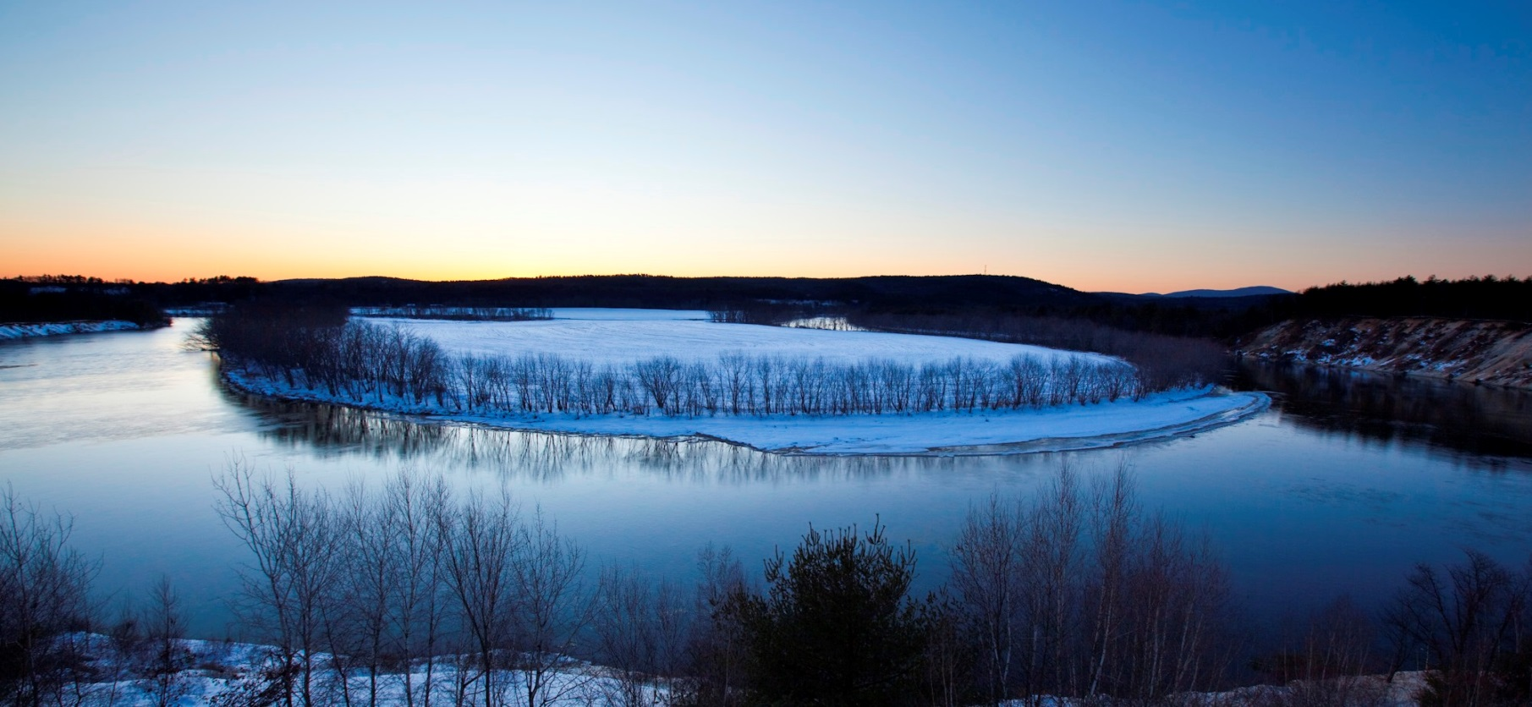
The Merrimack at Canterbury, NH

Slide 5
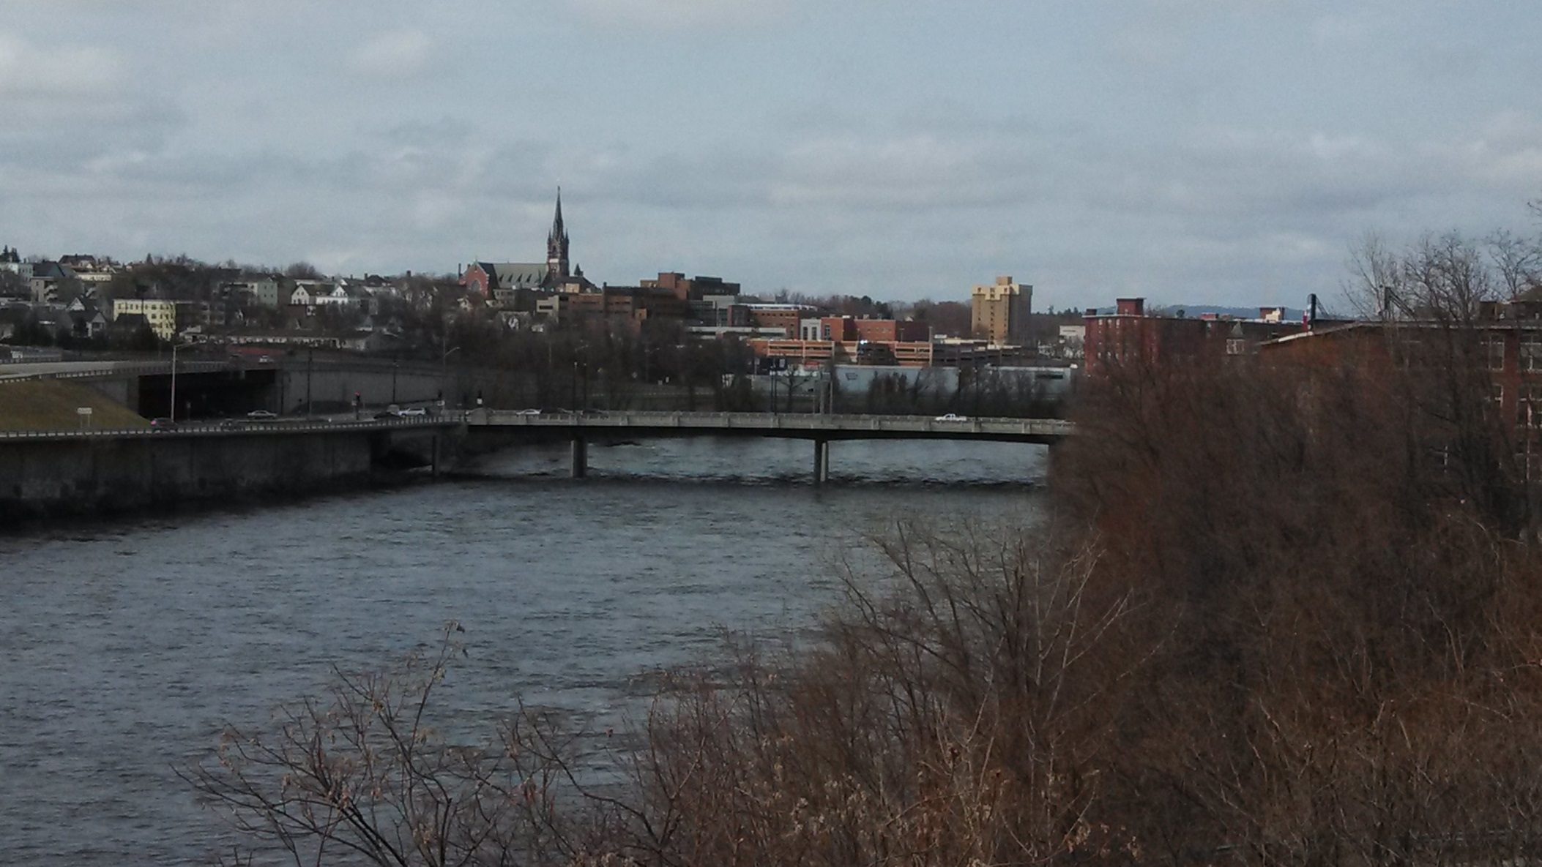
The Merrimack at Manchester, NH

Slide 6
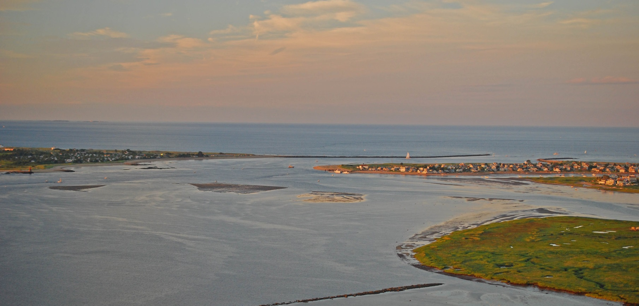
The Merrimack at Newburyport, MA

Slide 7
A Land Conservation Plan for the Merrimack Watershed
of NH and MA
A new science-driven, consensus based land conservation plan for the Merrimack watershed.
Product of two years of effort by conservation and planning professionals representing 33 private organizations and public agencies in NH and MA.
Integrates best-available natural resource data with expert judgment to prioritize land protection to protect water quality, habitat, farms and forests, and recreational open space.

Slide 8
MA Merrimack Towns
# Pop. Growth 2000-2010
(72K added total in MA watershed)
Town | State | 2000 Population | 2010 Population | # Change | % Change
Massachusetts
MERRIMAC | MA | 6,138 | 6,338 | 200 | 3.3%
METHUEN | MA | 43,789 | 47,255 | 3,466 | 7.9%
MIDDLETON | MA | 7,744 | 8,987 | 1,243 | 16.1%
NATICK | MA | 32,170 | 33,006 | 836 | 2.6%
NEWBURY | MA | 6,717 | 6,666 | -51 | -0.8%
NEWBURYPORT | MA | 17,189 | 17,416 | 227 | 1.3%
NORTH ANDOVER | MA | 27,202 | 28,352 | 1,150 | 4.2%
NORTH READING | MA | 13,837 | 14,892 | 1,055 | 7.6%
NORTHBOROUGH | MA | 14,013 | 14,155 | 142 | 1.0%
PAXTON | MA | 4,386 | 4,806 | 420 | 9.6%
PEABODY | MA | 48,129 | 51,251 | 3,122 | 6.5%

Slide 9
NH Merrimack Towns
# Pop. Growth 2000-2010
(42K added total in NH watershed)
Town | State | 2000 Population | 2010 Population | # Change | % Change
NEW HAMPSHIRE
BEDFORD | NH | 18,274 | 21,203 | 2,929 | 16.0%
WINDHAM | NH | 10,709 | 13,592 | 2,883 | 26.9%
MANCHESTER | NH | 107,006 | 109,565 | 2,559 | 2.4%
CONCORD | NH | 40,687 | 42,695 | 2,008 | 4.9%
PELHAM | NH | 10,914 | 12,897 | 1,983 | 18.2%
HOOKSETT | NH | 11,721 | 13,451 | 1,730 | 14.8%
MILFORD | NH | 13,535 | 15,115 | 1,580 | 11.7%
HUDSON | NH | 22,928 | 24,467 | 1,539 | 6.7%
NEW BOSTON | NH | 4,138 | 5,321 | 1,183 | 28.6%
HILLSBOROUGH | NH | 4,928 | 6,011 | 1,083 | 22.0%
WEARE | NH | 7,776 | 8,785 | 1,009 | 13.0%

Slide 10
Current status of Conservation in the Watershed
29% of all Massachusetts residents live in the MA portion of the Merrimack watershed, but the region only has 17% of the state’s conservation land.
57% of all New Hampshire residents live in NH portion of the Merrimack watershed (79 towns comprising 19% of the state’s land area);
NH portion of the Merrimack has only 10% of state’s conservation land.

Slide 11
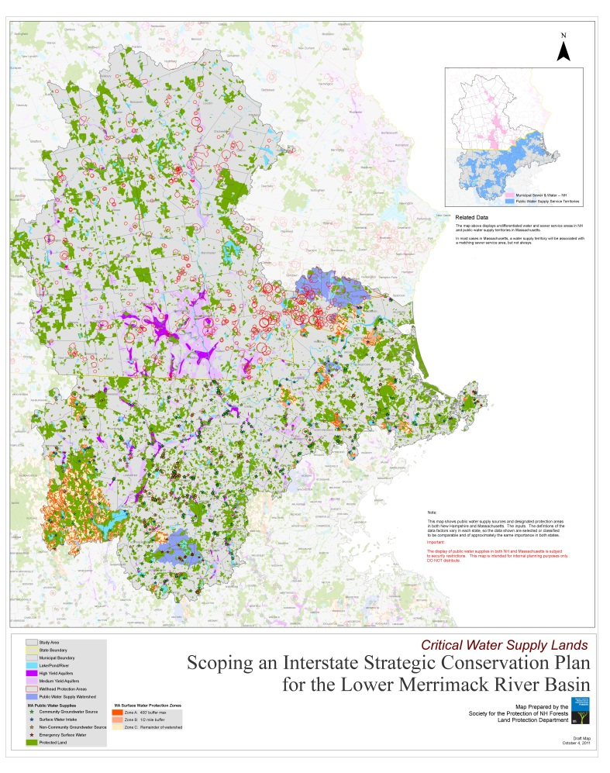
Watershed Conservation
17.6% of the Merrimack watershed is permanently conserved -- less than the share for New Hampshire as a whole (30.6%) or Massachusetts (24.5%).
In MA, 18% of the land classified as “source water protection area” by state regulators is in permanent conservation.
In NH, only 9.9% of all the land classified as “wellhead protection area” (of which there is 110,000 acres total) is in permanent conservation.

Slide 12
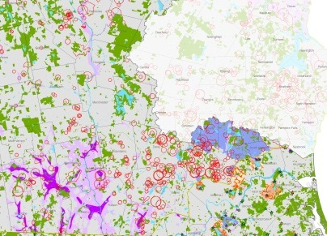
Watershed Conservation

Slide 13
Conservation of Wellhead Protection Areas in
Top Ten NH Towns by # Population Growth 2000-2010
Town | State | Total WHPA Acres | Acres WHPA Conserved | % WHPA Conserved
BEDFORD | NH | 1,839 | 37 | 2.0%
WINDHAM | NH | 6,954 | 324 | 4.7%
MANCHESTER | NH | 84 | 0 | 0.0%
CONCORD | NH | 1,167 | 37 | 3.2%
PELHAM | NH | 2,360 | 165 | 7.0%
HOOKSETT | NH | 1,048 | 80 | 7.7%
MILFORD | NH | 2,821 | 456 | 16.1%
HUDSON | NH | 738 | 63 | 8.5%
NEW BOSTON | NH | 1,443 | 2 | 0.1%
HILLSBOROUGH | NH | 1,055 | 88 | 8.3%

Slide 14
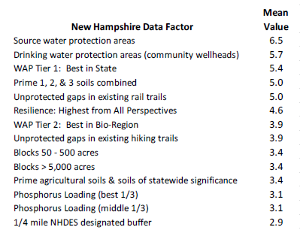
The Merrimack Plan and Water
The Merrimack conservation plan integrates 43 different GIS data sets;
Of these 15 were water-related, including drinking water and source water protection areas, aquifers, phosphorus and nitrogen loading data, wetlands, stream networks etc.
Each data set was weighted via “Delphi” voting (18 partners participated)
Water-related data is a key driver of the plan.

Slide 15
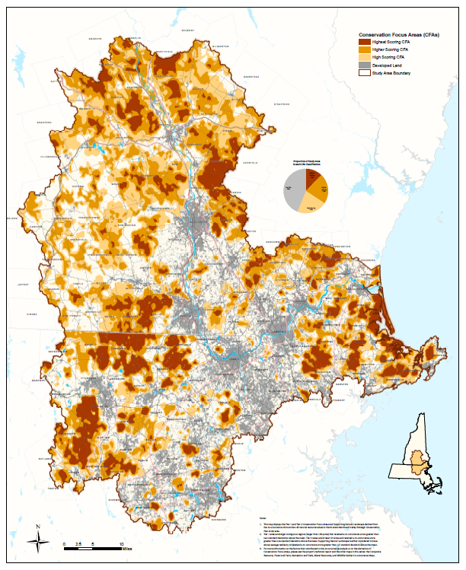
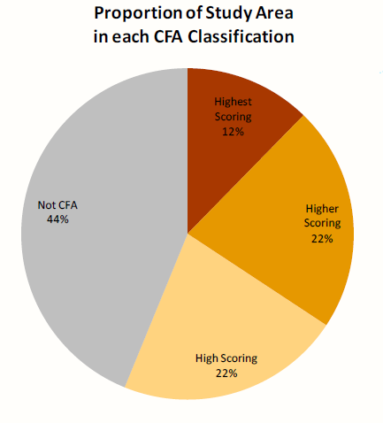
Plan Priorities
Tier 1 Conservation Focus Area (CFA) = “best of the best” highest scoring acres;
Tier 2 CFA = “next best” still very high scoring;
Tier 3 = “supporting landscape” that buffers and connects CFAs.

Slide 16
Plan Priority Areas:
Current Conservation Status

Slide 17
Plan Priority Areas:
Current Conservation Status

Slide 18
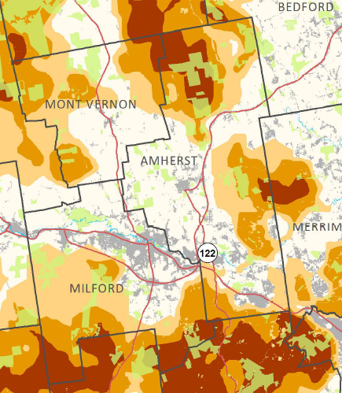
Example: Amherst, NH
 | Town ac. in Watershed | Tier ac. | Tier ac. as % of Town | Tier ac. Conserved | % of Tier ac. | Tier acres Not Conserv | % of Tier acres
Tier 1 | 22,025.3 | 1,958.4 | 8.9% | 620.3 | 31.7% | 1,338.1 | 68.3%
Tier 2 | 22,025.3 | 4,571.5 | 20.8% | 794.0 | 17.4% | 3,777.5 | 82.6%
Tier 3 | 22,025.3 | 4,848.2 | 22.0% | 359.7 | 7.4% | 4,488.5 | 92.6%

Slide 19
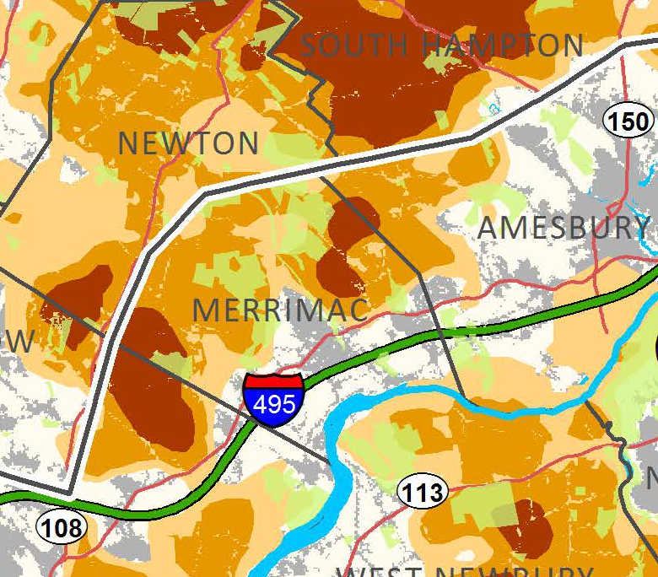
Example: Merrimac, MA
 | Town acres in Watershed | Tier Acres | Tier acres as % of Town | Tier acres Conserved | % of Tier acres | Tier acres Not Conserved | % of Tier acres
Tier 1 | 5,685 | 599 | 10% | 66 | 11% | 532 | 88%
Tier 2 | 5,685 | 2,165 | 38% | 595 | 27% | 1,570 | 72%
Tier 3 | 5,685 | 4,091 | 22% | 215 | 22% | 763 | 78%

Slide 20
NH Merrimack Watershed
Current Land Use
(1.13 M acres total)

Slide 21
Land Use if ALL Tier 1 Acres Conserved (+86K)

Slide 22
Land Use if all Tier 1
AND Tier 2 Acres Conserved (+244K)

Slide 23
Land Use if all Tier 1, 2
AND Tier 3 Acres Conserved (+262K)

Slide 24
What’s Next for the Partnership?
Outreach:
Public release of conservation plan – Spring 2014
Outreach to towns, Conservation groups and others Summer 2014 - summer 2015
Use plan for case-making with legislature to State Conservation Funding programs;
Establish a website 2015 (delivery of map and data)
(http://merrimackconservationpartnership.org/)

Slide 25
What’s Next for the Partnership?
Land Conservation:
Increase pace of land conservation activity by towns, state agencies and land trusts in the region by targeting priority lands;
Seek public and/or private funding to establish transaction grants program tied to plan implementation;
Maintain the Merrimack Conservation Partnership & track progress;
Other
Use plan (and complementary state-wide research) to integrate watershed land conservation into policy discussions around water infrastructure funding (the “$3 billion problem”);
Possible “Phase II” planning project looking at urbanized corridor along main-stem of Merrimack River with more emphasis on trails and local open space?;

Slide 26
For More Information
Brian Hotz
Society for the Protection of New Hampshire Forests
bhotz@forestsociety.org
(603) 224-9945
http://merrimackconservationpartnership.org/

Slide 27
Questions?

Slide 30
Conservation of Wellhead Protection Areas in
Top Ten NH Towns by Total Acres of WHPA
Town | State | Total WHPA Acres | Acres WHPA Conserved | % WHPA Conserved
WINDHAM | NH | 6,954 | 324 | 4.7%
DERRY | NH | 6,236 | 574 | 9.2%
HAMPSTEAD | NH | 5,298 | 500 | 9.4%
BOW | NH | 5,021 | 983 | 19.6%
ATKINSON | NH | 4,498 | 394 | 8.8%
PEMBROKE | NH | 4,394 | 94 | 2.1%
PLAISTOW | NH | 4,150 | 270 | 6.5%
EPSOM | NH | 3,528 | 46 | 1.3%
LOUDON | NH | 3,352 | 108 | 3.2%
LONDONDERRY | NH | 3,042 | 252 | 8.3%

Slide 31
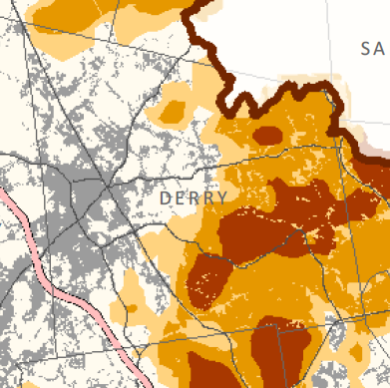
Example: Derry, NH
 | Town acres in Watershed | Tier Acres | Tier acres as % of Town | Tier acres Conserved | % of Tier acres | Tier acres Not Conserved | % of Tier acres
Tier 1 | 22,731 | 2,628 | 11.6% | 467 | 17.8% | 2,162 | 82.2%
Tier 2 | 22,731 | 5,354 | 23.6% | 508 | 9.5% | 4,846 | 90.5%
Tier 3 | 22,731 | 4,091 | 18.0% | 320 | 7.8% | 3,771 | 92.2%
 | 22,731 | 12,073 | 53.1% | 1,295 | 10.7% | 10,778 | 89.3%

Slide 32
NH Merrimack Towns
% Pop. Growth 2000-2010
Town | State | 2000 Population | 2010 Population | # Change | % Change
NEW HAMPSHIRE
EAST KINGSTON | NH | 1,784 | 2,357 | 573 | 32.1%
NEW BOSTON | NH | 4,138 | 5,321 | 1,183 | 28.6%
WINDHAM | NH | 10,709 | 13,592 | 2,883 | 26.9%
CHESTER | NH | 3,792 | 4,768 | 976 | 25.7%
DUNBARTON | NH | 2,226 | 2,758 | 532 | 23.9%
GILMANTON | NH | 3,060 | 3,777 | 717 | 23.4%
HILLSBOROUGH | NH | 4,928 | 6,011 | 1,083 | 22.0%
SALISBURY | NH | 1,137 | 1,382 | 245 | 21.5%
MASON | NH | 1,147 | 1,382 | 235 | 20.5%
BROOKLINE | NH | 4,181 | 4,991 | 810 | 19.4%

Slide 33
NH Merrimack Towns
# Pop. Growth 2000-2010
(42K added total in NH watershed)
Town | State | 2000 Population | 2010 Population | # Change | % Change
NEW HAMPSHIRE
AMHERST | NH | 10,769 | 11,201 | 432 | 4.0%
BEDFORD | NH | 18,274 | 21,203 | 2,929 | 16.0%
WINDHAM | NH | 10,709 | 13,592 | 2,883 | 26.9%
MANCHESTER | NH | 107,006 | 109,565 | 2,559 | 2.4%
CONCORD | NH | 40,687 | 42,695 | 2,008 | 4.9%
PELHAM | NH | 10,914 | 12,897 | 1,983 | 18.2%
HOOKSETT | NH | 11,721 | 13,451 | 1,730 | 14.8%
MILFORD | NH | 13,535 | 15,115 | 1,580 | 11.7%
HUDSON | NH | 22,928 | 24,467 | 1,539 | 6.7%
NEW BOSTON | NH | 4,138 | 5,321 | 1,183 | 28.6%
HILLSBOROUGH | NH | 4,928 | 6,011 | 1,083 | 22.0%

